Slide 1
8/11/17
EternaBrain – Rohan Koodli

Slide 2
Trying
Prepping more data
hoglahoo (1.2K puzzles)
20 experts
Writing the paper
Fixing bugs
Testing EteRNABot on the Eterna100

Slide 3
Methods
92 puzzles, 30K moves, 72 experts (solved over 3000 puzzles each)
Convolutional neural net, 10 convolutional layers (with pooling), 3 fully-connected, 150 epochs, 0.9 keep prob
2D convolutions (height 8/9 to match number of features, 8/9 nearest neighbors)
But essentially 1D convolutions with 8/9 nearest neighbors
https://github.com/eternagame/EternaBrain/blob/master/rna-prediction/baseCNN.py
https://github.com/eternagame/EternaBrain/blob/master/rna-prediction/locationCNN.py

Slide 4
Methods
Single Action Playout (SAP) which goes through each individual base and mutates it to A, U, G, or C and sees which brings it closer to target structure, corrects base pairings, and other minor fixes
https://github.com/eternagame/EternaBrain/blob/master/rna-prediction/predict_pm.py
https://github.com/eternagame/EternaBrain/blob/master/rna-prediction/fix.py
https://github.com/eternagame/EternaBrain/blob/master/rna-prediction/dsp.py

Slide 5
Cross-Validation Accuracies
baseCNN
Train Accuracy: 0.75
Test Accuracy: 0.51
locationCNN
Train Accuracy: 0.31
Test Accuracy: 0.34

Slide 6
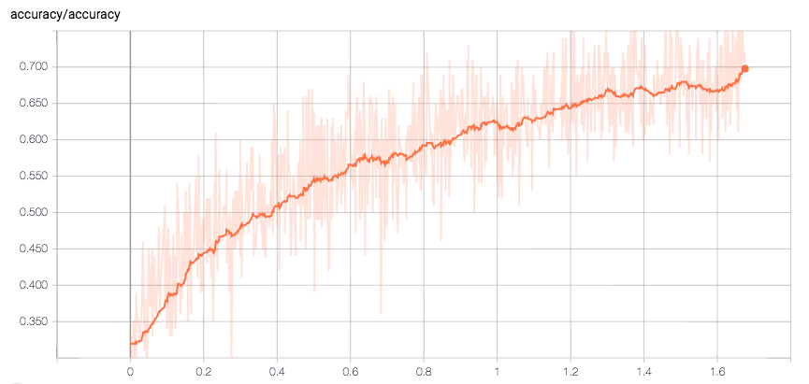
Base Training Accuracy over epochs

Slide 7
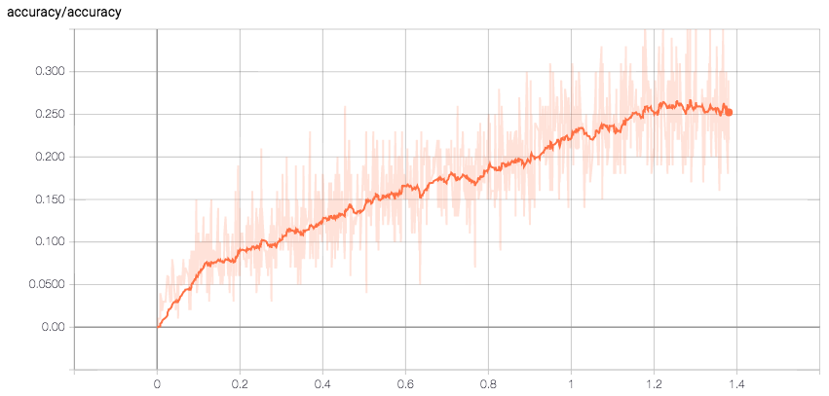
Location Training Accuracy over epochs

Slide 8
Eterna100
✔️ = Solved
✖️ = Couldn’t solve

Slide 9
EternaBrain v/s EteRNABot

Slide 10
Results
Solved 61/100 of Eterna100
RNA-SSD: 27/100
RNAinverse: 28/100
DSS-Opt: 47/100
NUPACK: 48/100
INFO-RNA: 50/100
MODENA: 54/100
EteRNABot: 27/100
EternaBrain: 61/100

Slide 11
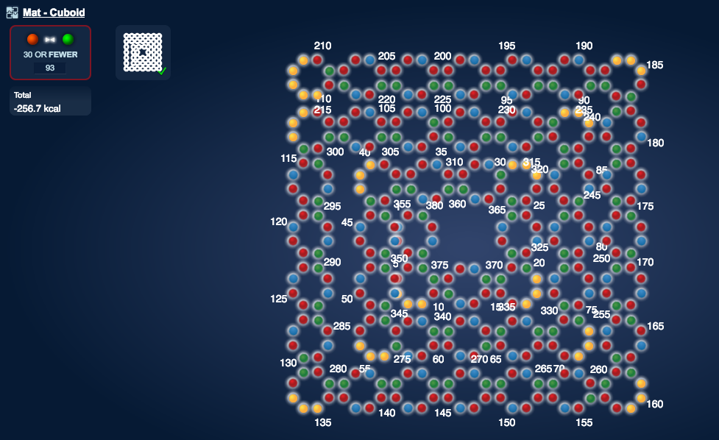
Results
Cuboid

Slide 12
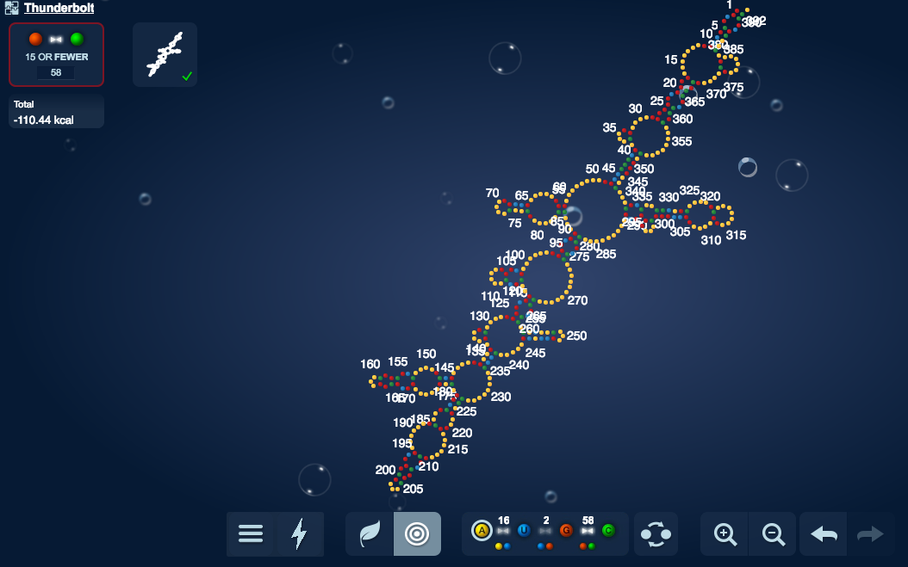
Results
Thunderbolt

Slide 13
Conclusions
Solved a total of 61, surpassing the best (MODENA) by 7
EteRNABot did surprisingly bad, solving just 27/100, which is nearly the same as RNAinverse and RNA-SSD
Could retest
Could probably solve more if given multiple tries on each puzzle (perhaps up to 30)
But unlikely to fare better than DSS-Opt, MODENA, NuPACK, or INFO-RNA

Slide 14
Next Steps
Train with more specific data
hoglahoo
20 experts
Vary hyperparameters
Convolution size, dropout, epochs
Fix bugs in playouts
Work on paper more
Test on separate benchmark

